Slide 1
Mentorness Project 1
April 17, 2024
Game Analysis with SQL
AMALJITH C K
By:

Slide 2

Contents
1
Objectives
3
Conclusion
2
Queries

Slide 3

Objective
Here we are given two datasets related to a game.The dataset includes two tables `Player Details` and `Level Details`.
After studying the data and performing some preprocessing, there are 15 questions that we have to answer.
Our analysis is completely done in MySQL Workbench. Firstly, we import the two datasets into a new database.

Slide 4
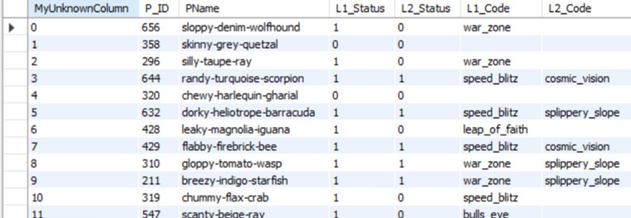
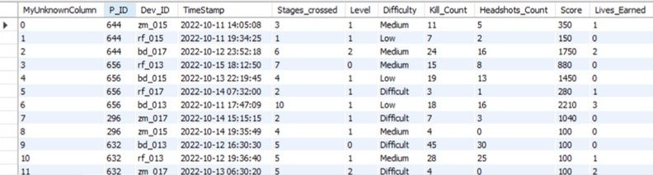
These are the datasets before preprocess

Slide 5
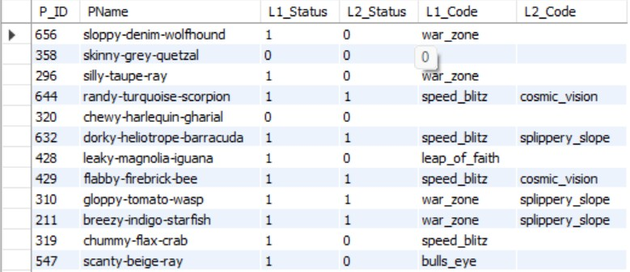
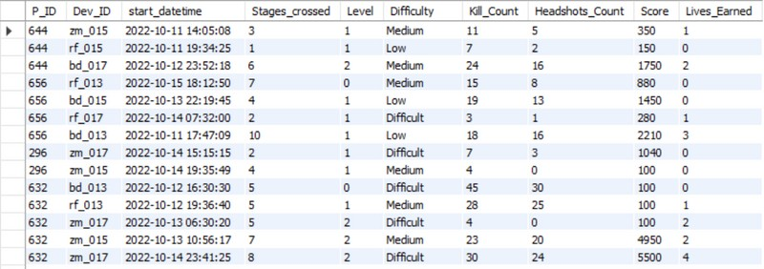
Datasets after preprocess
Datasets
These are our 2 datasets in tabular form Query: select * from player_details
select * from level_details2

Slide 6
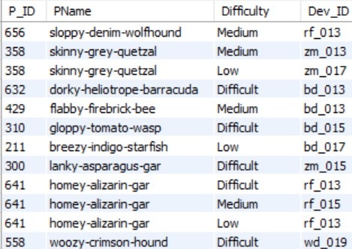
Q1. Extract `P_ID`, `Dev_ID`, `PName`, and `Difficulty_level` of all players at Level 0.
SELECT level_details2.P_ID, level_details2.Dev_ID, player_details.PName, level_details2.Difficulty FROM level_details2
JOIN player_details ON level_details2.P_ID = player_details.P_ID WHERE level_details2.Level = 0;

Slide 7

Q2. Find `Level1_code`wise average `Kill_Count` where
`lives_earned` is 2, and at least 3 stages are crossed.
select player_details. L1_Status, avg(Kill_Count) from level_details2 |
left join player_details on level_details2.P_ID=player_details.P_ID where level_details2.Lives_Earned=2
and level_details2.Stages_crossed>=3 group by player_details.L1_Status

Slide 8
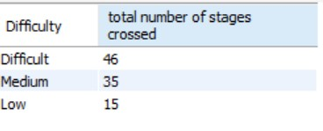
select level_details2. Difficulty, sum(level_details2.Stages_crossed) as 'total number of stages crossed' from level_details2
left join player_details on level_details2.P_ID=player_details.P_ID where level_details2.Dev_ID like "zm%" and level_details2.Level=2
Q3. Find the total number of stages crossed at each difficulty level for Level 2 with players using `zm_series` devices. Arrange the result in decreasing order of the total number of stages crossed.
group by level_details2.Difficulty order by 'total number of stages crossed' desc;

Slide 9
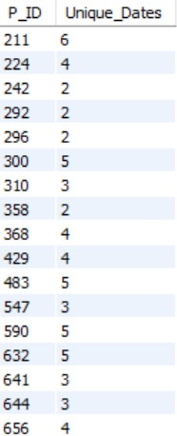
Q4. Extract `P_ID` and the total number of unique dates for those players who have played games on multiple days.
SELECT P_ID, COUNT(DISTINCT start_datetime) AS Unique_Dates
FROM level_details2 GROUP BY P_ID
HAVING COUNT(DISTINCT start_datetime) > 1;

Slide 10
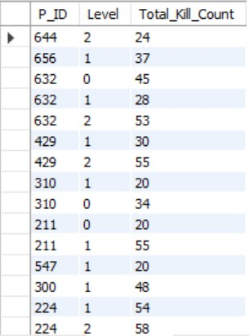
Q5. Find `P_ID` and levelwise sum of `kill_counts` where `kill_count` is greater than the average kill count for Medium difficulty.
WITH MediumAvg AS (
SELECT AVG(kill_count) AS Avg_kill_Count FROM level_details2
WHERE Difficulty = 'Medium' SELECT P_ID, Level, SUM(kill_count) AS
Total_Kill_Count FROM level_details2
WHERE kill_count > (SELECT Avg_Kill_Count FROM MediumAvg)
GROUP BY P_ID, Level;

Slide 11
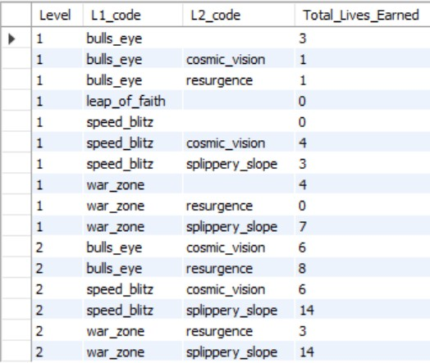
Q6. Find `Level` and its corresponding `Level_code`wise sum of lives earned, excluding Level0. Arrange in ascending order of level.
SELECT level_details2.Level, player_details.L1_code, player_details.L2_code, SUM(level_details2.lives_earned) AS Total_Lives_Earned
FROM level_details2
INNER JOIN player_details ON level_details2.P_ID= player_details.P_ID
WHERE level_details2.Level!=0 GROUP BY level_details2.Level,
player_details.L1_code, player_details.L2_code ORDER BY level_details2.Level ASC;

Slide 12
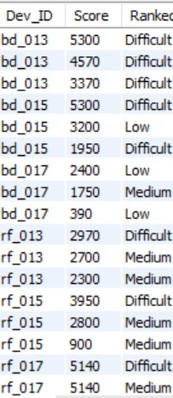
Q7. Find the top 3 scores based on each `Dev_ID` and rank them in increasing order using Row_Number`. Display the difficulty as well.
with table1 as
(select Dev_ID, Difficulty, Score, row_number() over (partition by Dev_ID order by Score desc)
as Ranked from level_details2)
select Dev_ID, Score, Difficulty Ranked from table1 where Ranked<=3;

Slide 13
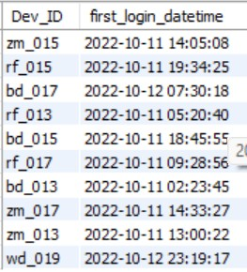
Q8. Find the `first_login` datetime for each device ID.
SELECT Dev_ID, MIN(start_datetime) AS first_login_datetime
FROM level_details2 GROUP BY Dev_ID;

Slide 14
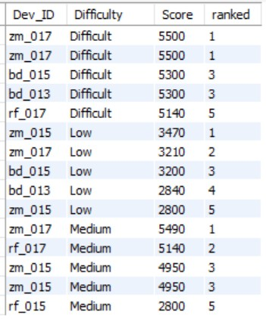
Q9. Find the top 5 scores based on each difficulty level and rank them in increasing order using `Rank`. Display `Dev_ID` as well.
with table2 as
(select Dev_ID, Score, Difficulty, rank() over (partition by Difficulty order by Score desc)
as ranked from level_details2)
select Dev_ID, Difficulty, Score, ranked from table2 where Ranked<=5;

Slide 15
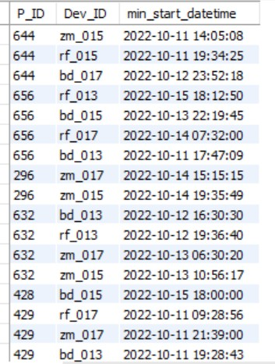
Q10. Find the device ID that is first logged in (based on
`start_datetime`) for each player (`P_ID`). Output should contain player ID, device ID, and first login datetime..
SELECT P_ID, Dev_ID, MIN(start_datetime) AS min_start_datetime
FROM level_details2 GROUP BY Dev_ID, P_ID;

Slide 16
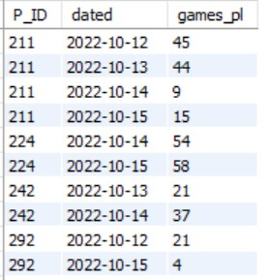
Q11. For each player and date, determine how many `kill_counts` were played by the player so far.
Using window functions
Without window functions
a) SELECT distinct P ID, cast(start datetime as date) as dated,
SUM(Kill Count) OVER (PARTITION BY P_ID, cast(start datetime as date) order by cast(start datetime as date)) AS
games_pl FROM level_details2 order by P_ID, dated;
b) SELECT P_ID, cast(start_datetime as date) as dated, SUM(Kill_Count) FROM level_details2 group by P_ID, cast(start_datetime as date) order by P_ID, dated;

Slide 17
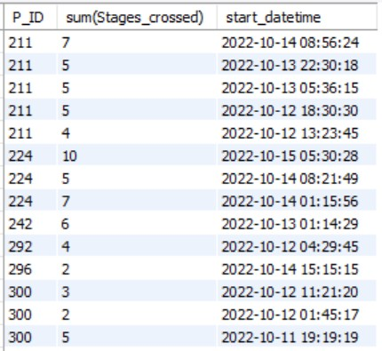
Q12. Find the cumulative sum of stages crossed over `start_datetime` for each
`P_ID`, excluding the most recent `start_datetime`.
with cstages as (select P_ID, Stages_crossed, start_datetime, row_number()
over (partition by P_ID order by start_datetime desc) as rn from
level_details2)
select P_ID, sum (Stages_crossed), start_datetime from cstages
where rn>1 group by P_ID, start_datetime;

Slide 18
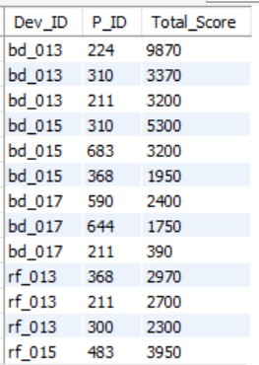
Q13. Extract the top 3 highest sums of scores for each `Dev_ID` and the corresponding `P_ID`.
WITH RankedScores AS ( SELECT FROM P_ID, Dev_ID, SUM(Score) AS Total Score,
ROW_NUMBER() OVER (PARTITION BY Dev_ID ORDER
BY SUM(Score) DESC) AS ranked from level_details2
GROUP BY Dev_ID, P_ID)
SELECT Dev_ID, P_ID, Total Score from RankedScores WHERE ranked <= 3;

Slide 19
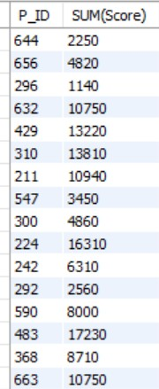
Q14. Find players who scored more than 50% of the average score, scored
sum of scores for each `P_ID`.
select P_ID, SUM(Score) from level_details2 group by P_ID
having sum(Score)>0.5*(select avg(Score) from
level_details2);

Slide 20
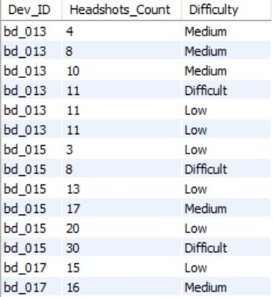
Q15. Create a stored procedure to find the top `n` `headshots_count` based on each `Dev_ID` and rank them in increasing order using `Row_Number`. Display the difficulty as well.
DELIMITER //
CREATE PROCEDURE MajorTopN(IN n INT) BEGIN
SELECT Dev_ID, Headshots_Count, Difficulty FROM(
SELECT
Dev_ID, Headshots_Count, Difficulty,
ROW_NUMBER() OVER (PARTITION BY Dev_ID ORDER
BY Headshots_Count) AS ranked FROM
level_details2) AS cstages WHERE ranked <= n;
END // DELIMITER ;
call MajorTopN(6)

Slide 21
Sub Queries
Window Functions
Aggregate Functions
Stored Procedure

Slide 22

Thank you!
Have
a good
weekend!

